Slide 1
260520 Meeting
Dylan Junluo CHEN
Supervisor: Ben LIU & Xin LI

Slide 2
Outline
围绕competition逻辑的两个故事(contribution和innovation)，寻找可行的交互结果
做了基于 opus 4.7以及deepseek-v4-pro的质量度量 → 整理了当前的可用的结果
做了之前提到的 lexicon-based personal experience DV，没有显著结果。

Slide 3
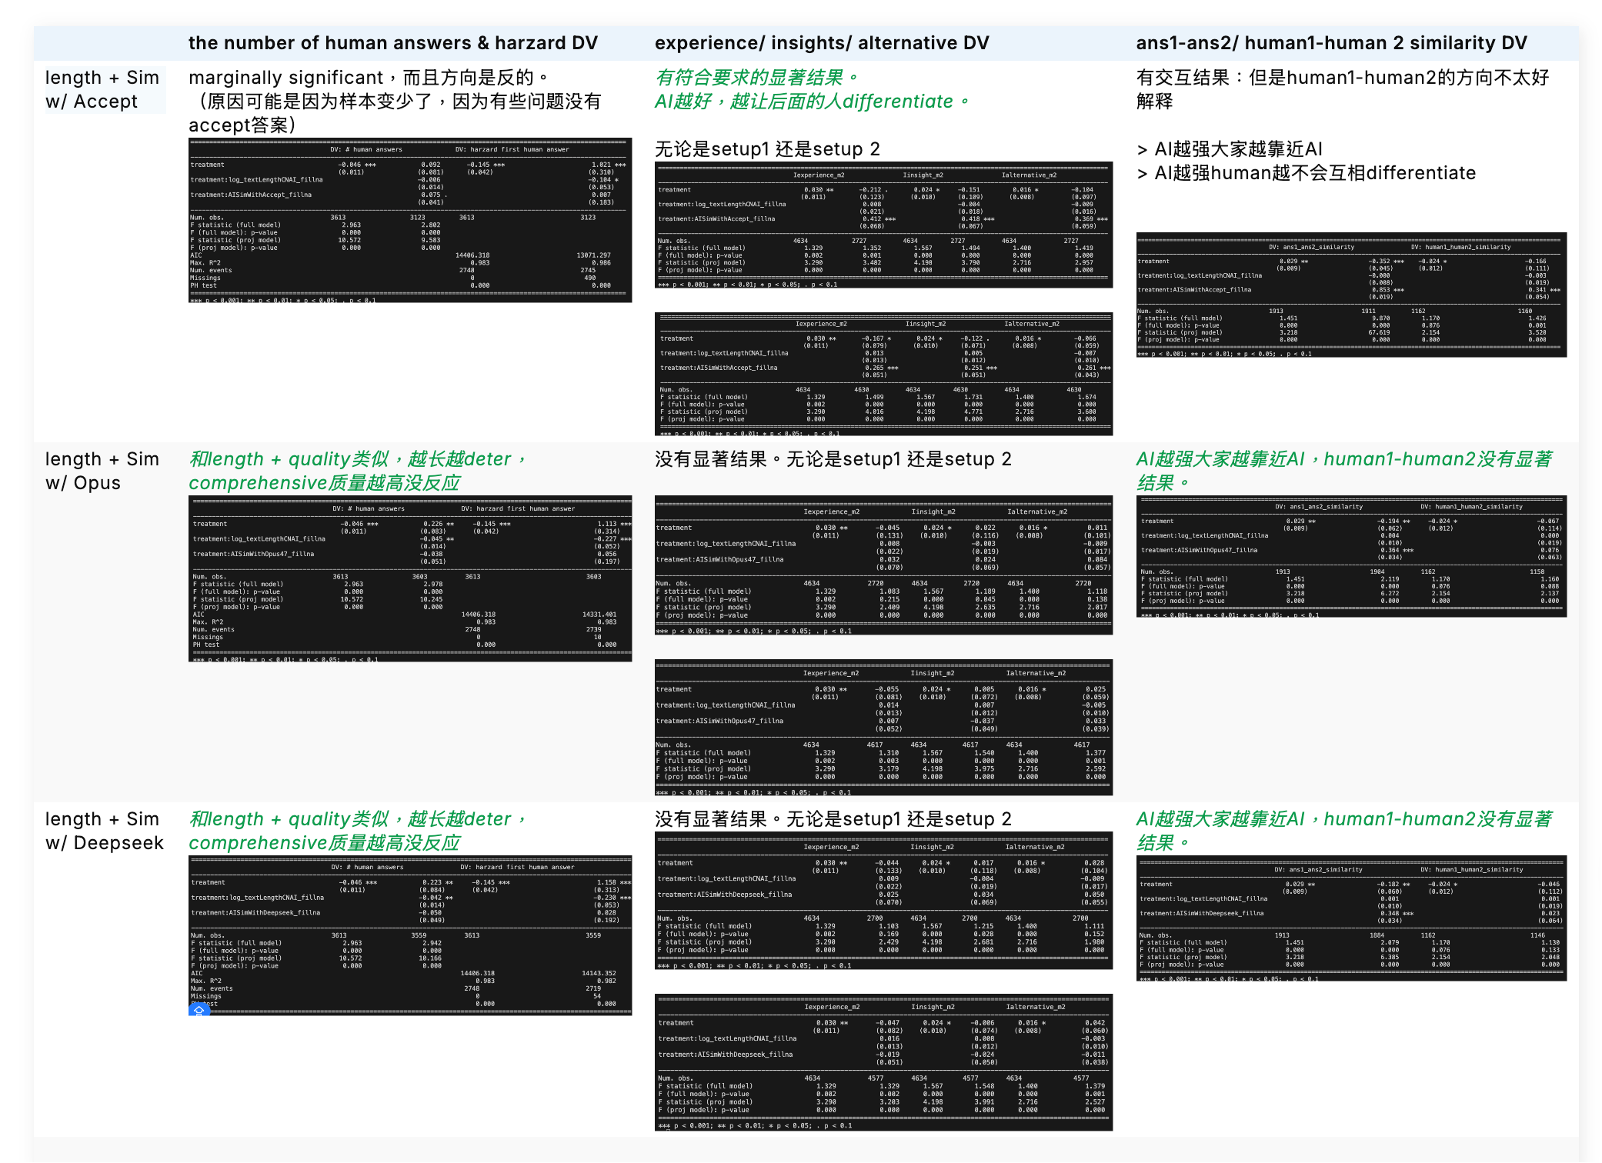
Opus + Deepseek results
所有的分析都是
Treament + treatment:AILength + treatment:Sim w/ XXX

Slide 4
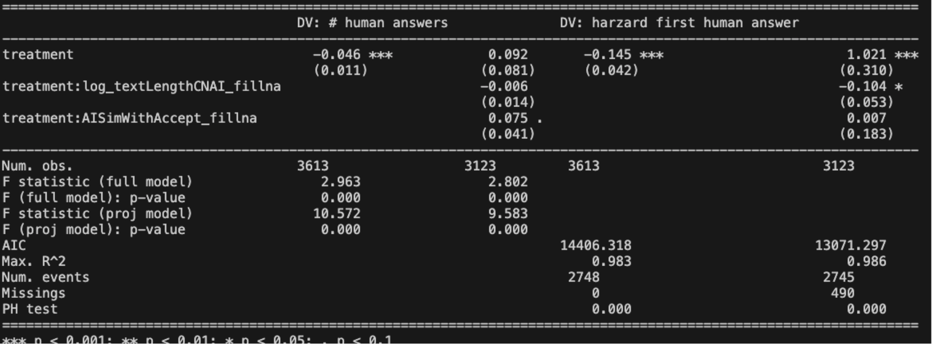
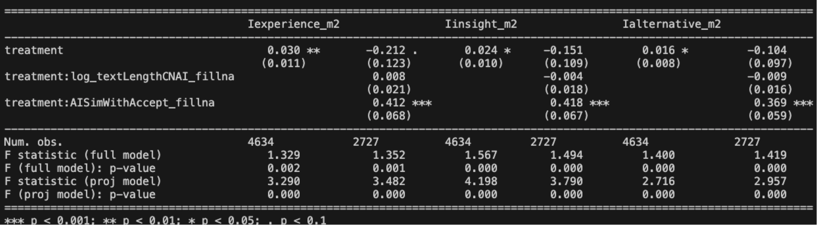
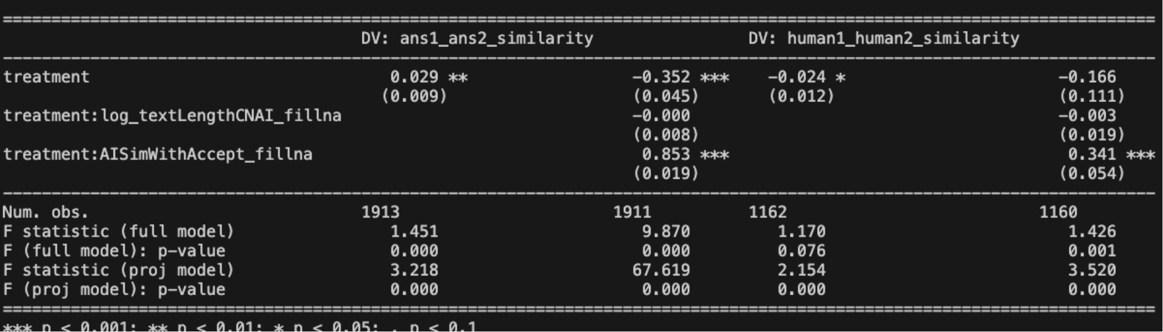

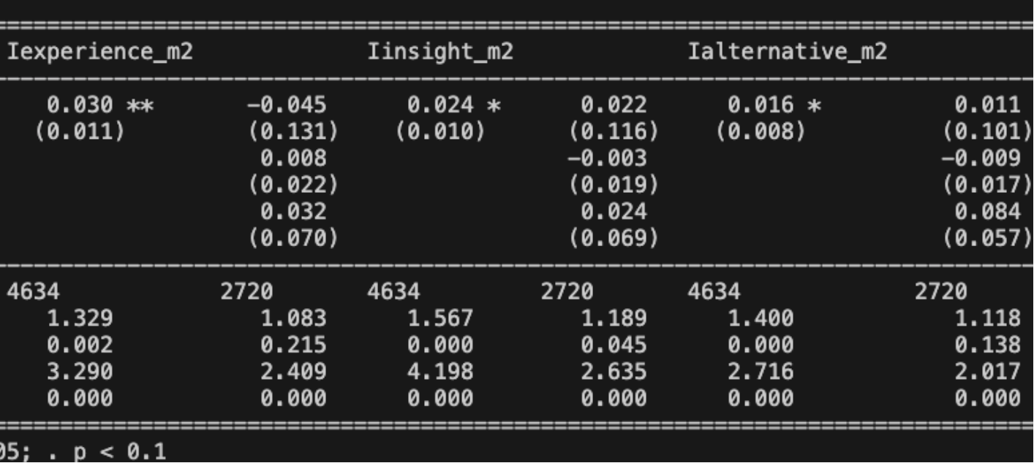
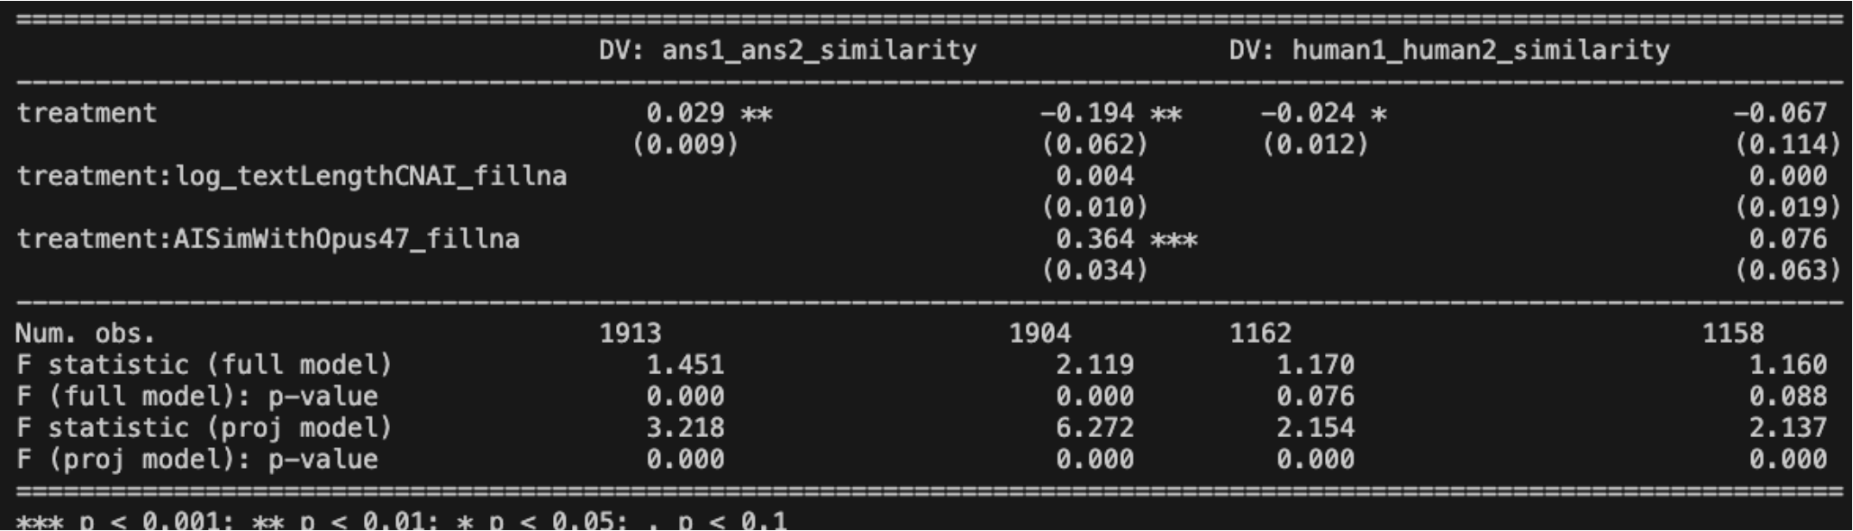
Opus + Deepseek results
quality1Ans, DV-> # other answer
Sample: 2nd answer
quality1Ans, DV-> # other answer
Sample: 2nd answer

Slide 5
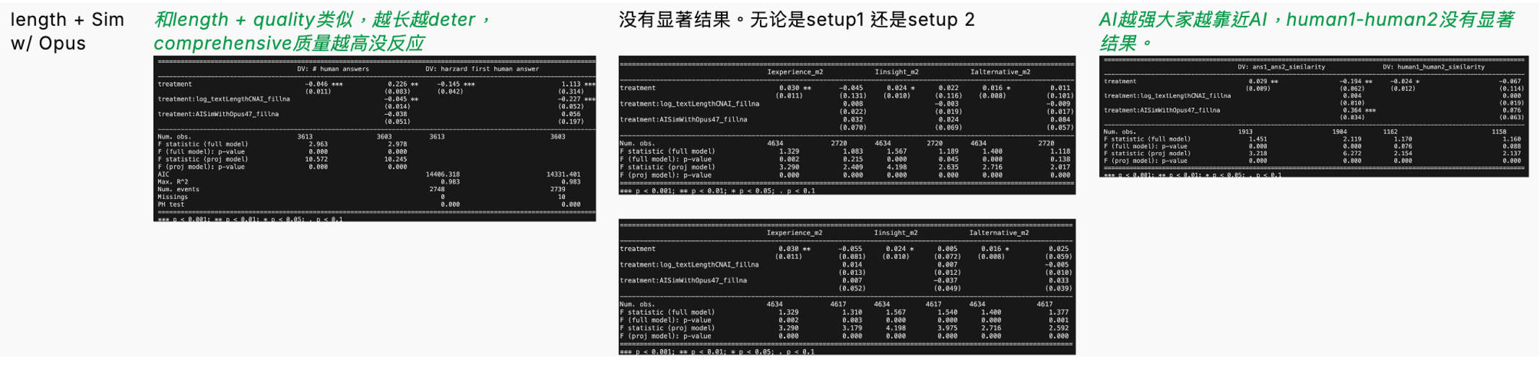
Opus + Deepseek results

Slide 6
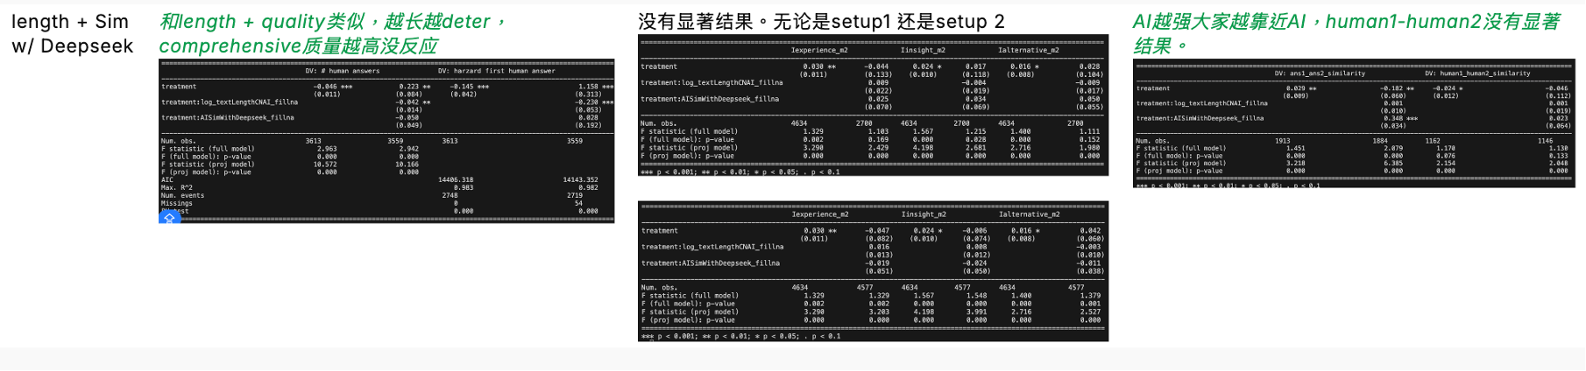
Opus + Deepseek results
 | DV: # human answers |  | DV: first human answer harzard
 | (1) | (2) | (3) | (4)
Treatment | -0.046*** | 0.223** | -0.145*** | 1.158***
 | (0.011) | (0.084) | (0.042) | (0.313)
Treatment:AI Length (log, fillNA) |  | -0.042** |  | -0.230***
 |  | (0.014) |  | (0.053)
Treatment:AI Sim w/ DeepSeek (fillNA) |  | -0.050 |  | 0.028
 |  | (0.049) |  | (0.192)
Num. obs. | 3613 | 3559 | 3613 | 3559
F statistic (full model) | 2.963 | 2.942
F (full model): p-value | 0.000 | 0.000
F statistic (proj model) | 10.572 | 10.166
F (proj model): p-value | 0.000 | 0.000
AIC |  |  | 14406.318 | 14143.352
Max. R2 |  |  | 0.983 | 0.982
Num. events |  |  | 2748 | 2719
Missings |  |  | 0 | 54
PH test |  |  | 0.000 | 0.000
 | DV: Answer 1–2 Similarity |  | DV: Human 1–2 Similarity
 | (1) | (2) | (3) | (4)
Treatment | 0.029** | -0.182** | -0.024* | -0.046
 | (0.009) | (0.060) | (0.012) | (0.112)
Treatment:AI Length (log, fillNA) |  | 0.001 |  | 0.001
 |  | (0.010) |  | (0.019)
Treatment:AI Sim w/ DeepSeek (fillNA) |  | 0.348*** |  | 0.023
 |  | (0.034) |  | (0.064)
Num. obs. | 1913 | 1884 | 1162 | 1146
F statistic (full model) | 1.451 | 2.079 | 1.170 | 1.130
F (full model): p-value | 0.000 | 0.000 | 0.076 | 0.133
F statistic (proj model) | 3.218 | 6.385 | 2.154 | 2.048
F (proj model): p-value | 0.000 | 0.000 | 0.000 | 0.000

Slide 7
Lexicon-based DV (answer level analysis like innovation)
Setup 2: only first human sample
Setup 1: all human sample
 | DV: Lexicon Personal Experience
 | (1) | (2) | (3) | (4) | (5)
Treatment | -0.002 | -0.026· | -0.022 | -0.029 | -0.021
 | (0.003) | (0.015) | (0.016) | (0.019) | (0.017)
Treatment:AI Length (log, fillNA) |  | 0.003 | 0.004 | 0.004 | 0.004
 |  | (0.003) | (0.003) | (0.003) | (0.003)
Treatment:AI Quality (fillNA) |  | 0.001
 |  | (0.001)
Treatment:AI Sim w/ Accept (fillNA) |  |  | -0.003
 |  |  | (0.013)
Treatment:AI Sim w/ Opus 4.7 (fillNA) |  |  |  | 0.012
 |  |  |  | (0.018)
Treatment:AI Sim w/ DeepSeek (fillNA) |  |  |  |  | -0.005
 |  |  |  |  | (0.021)
Num. obs. | 2748 | 2747 | 2745 | 2739 | 2719
F statistic (full model) | 1.107 | 1.101 | 1.098 | 1.100 | 1.097
F (full model): p-value | 0.160 | 0.174 | 0.180 | 0.175 | 0.182
F statistic (proj model) | 0.606 | 0.574 | 0.575 | 0.576 | 0.575
F (proj model): p-value | 0.972 | 0.985 | 0.985 | 0.984 | 0.985
 | DV: Lexicon Personal Experience
 | (1) | (2) | (3) | (4) | (5)
Treatment | 0.002 | -0.028· | -0.024 | -0.016 | -0.015
 | (0.003) | (0.015) | (0.016) | (0.016) | (0.016)
Treatment:AI Length (log, fillNA) |  | 0.004 | 0.005· | 0.005· | 0.005·
 |  | (0.003) | (0.003) | (0.003) | (0.003)
Treatment:AI Quality (fillNA) |  | 0.001
 |  | (0.001)
Treatment:AI Sim w/ Accept (fillNA) |  |  | 0.001
 |  |  | (0.013)
Treatment:AI Sim w/ Opus 4.7 (fillNA) |  |  |  | -0.014
 |  |  |  | (0.019)
Treatment:AI Sim w/ DeepSeek (fillNA) |  |  |  |  | -0.016
 |  |  |  |  | (0.018)
Num. obs. | 4670 | 4668 | 4663 | 4652 | 4612
F statistic (full model) | 0.853 | 0.855 | 0.852 | 0.854 | 0.855
F (full model): p-value | 0.924 | 0.922 | 0.926 | 0.923 | 0.921
F statistic (proj model) | 0.866 | 0.855 | 0.831 | 0.850 | 0.817
F (proj model): p-value | 0.701 | 0.725 | 0.763 | 0.733 | 0.784

Slide 8
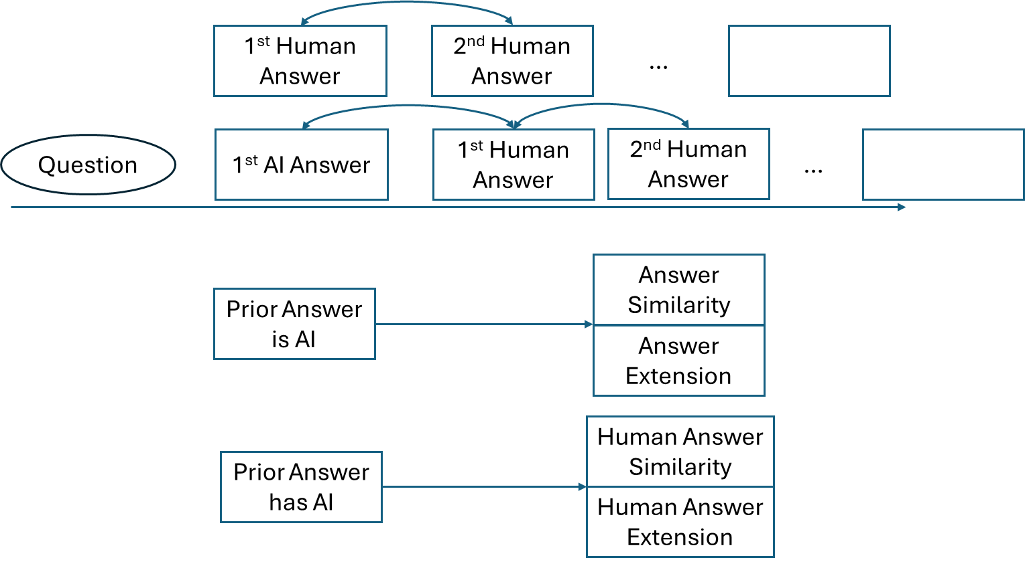
✅
Outline
✅
competition logic results
AI → answerNum & timeliness
AI → innovation
"前一个是 AI" vs "前一个是 Human"
AI 在场如何影响 Human2 vs Human1
✅
✅
DV: 2ndAnsInnovation
IV: firstAnsSimWithAccept
Sample: only second answer
Alternative become Column 1

Slide 9
Opus + Deepseek results

